Slide 1

2027 Annual Campaign
Sioux Empire United Way

Slide 2


ABOUT
SIOUX EMPIRE UNITED WAY

Slide 3



SEUW INTRODUCTION
Funds 77 programs at 42 nonprofit partners
33+ communities are served in our 4-county service area
Sioux Empire United Way impacts 1 in 3 individuals in the Sioux Empire
Operates with just 9 paid staff and hundreds of volunteers
Funds stay local
Notes:
Taryn

Slide 4
WHO WE’RE FIGHTING FOR
Investing in children
Reaching vulnerable adults
Helping people in crisis

Slide 5
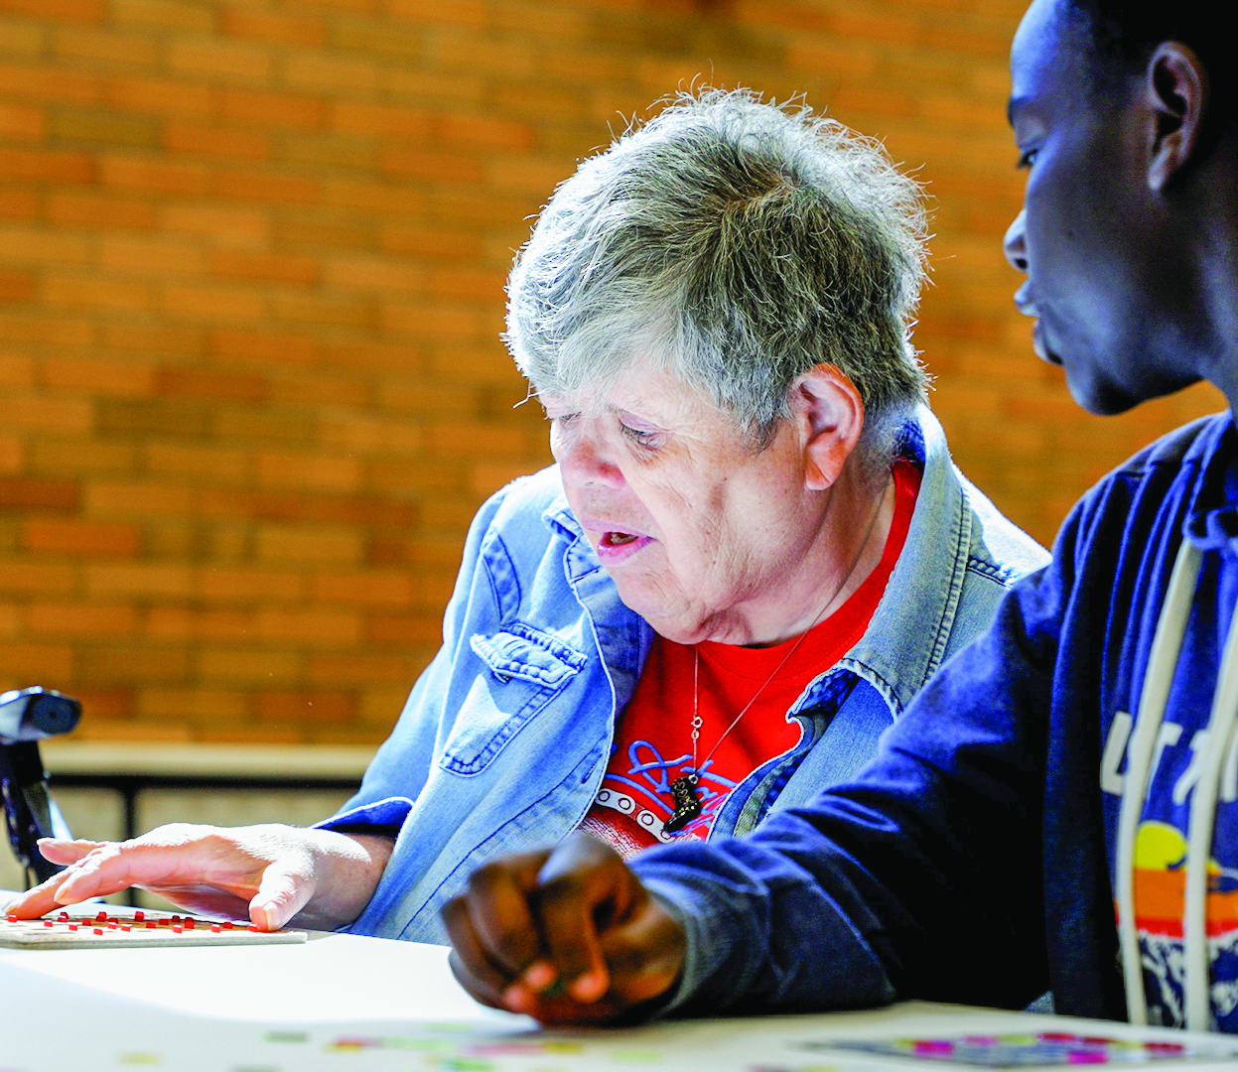
COMMUNITY
IMPACT

Slide 6
2027 FUNDING DECISIONS
Approximately 60 volunteers spend 1,000+ hours reviewing applications
42 nonprofit organizations, supporting 77 programs
42
nonprofits
60
volunteers
1000+
hours
Notes:
Lisa S

Slide 7
HOW DO WE DECIDE FUNDING?
NEED
Clear need within the community
MANAGEMENT
Overall efficiencies/effectiveness
OUTCOMES
Strong impact/outcomes
FINANCIAL PATTERN
Financial need for SEUW support is shown

Slide 8
COMMUNITY IMPACT TIMELINE
December-January
February
Applications available
Volunteer preparations
March-April
May
Review process
The Campaign goal is set!

Slide 9


Slide 10


Slide 11
$9,408,010

Slide 12
HEART CLUB
RISING HEART
Heart Club is the leadership giving program of Sioux Empire United Way
Any individual who gives $500 or more (about $10/week) is considered a Heart Club member.
Rising Heart is Sioux Empire United Way’s introductory level to Heart Club.
Givers make a minimum pledge of $250 (or $5/week) with a plan to increase their pledge over six years to $500 (or $10/week)

Slide 13

Rising Heart ($250-$499)
Golden Heart ($500-$749)
Golden Heart Plus ($750-$999)
Grand Heart ($1,000-$1,499)
Grand Heart Plus ($1,500-$1,999)
HEART CLUB
CEO
Bronze ($2,000-$3,499)
Silver ($3,500-$4,999)
Gold ($5,000-$9,999)
HEART OF A LEADER
ALEXIS DE
TOCQUEVILLE SOCIETY
Membres de la Société ($10,000-$24,999)
Ordre de Liberté ($25,000-$49,999)
Ordre d’Egalite ($50,000-$74,999)
Ordre de Fraternite ($75,000-$99,000)
La Societe Nationale ($100,000-$249,000)

Slide 14
THANK YOU!

